Slide 1
MATHEMATICS I
FIRST SEMESTER
03
Functions and Their Graphs
By Dr. Shaimaa Amen/Material engineering department/1st Grade/Calculus I

Slide 2
Outlines
Function
Domain and Range
Graphs of Functions
Piecewise-Defined Functions
The Greatest and Least Integer Functions
Types of functions
Even Functions and Odd Functions: Symmetry
Composite Functions
Shifting a Graph of a Function
-Vertical Shifts
- Horizontal Shifts

Slide 3
Functions
A function from a set D to a set Y is a rule that assigns a unique
(single) element ƒ(x) ϵ Y to each element x ϵ D.
”A symbolic way to say “y is a function of x” is bywriting
y = ƒ(x) (“y equals ƒ of x”).
The symbol ƒ represents the function. The letter x, called the independent variable, represents the input value of ƒ, and y, the dependent variable, represents the corresponding output value of ƒ at x.

Slide 4
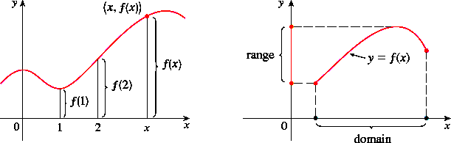

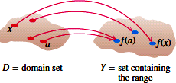
Domain and Range
Domain: The set from which the value of x can be chosen is called the
domain of the function.
Range: The set of all values of y is called the range of the function.

Slide 5
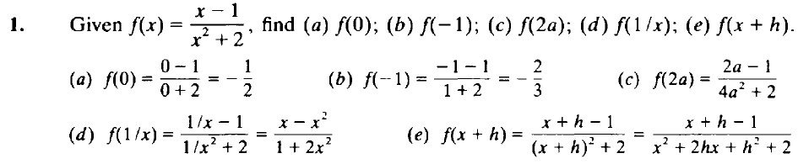
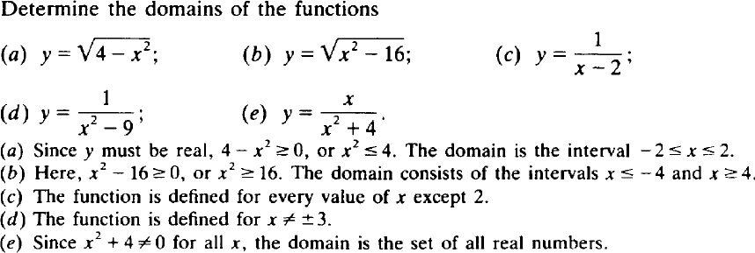
Solved function
2.

Slide 6
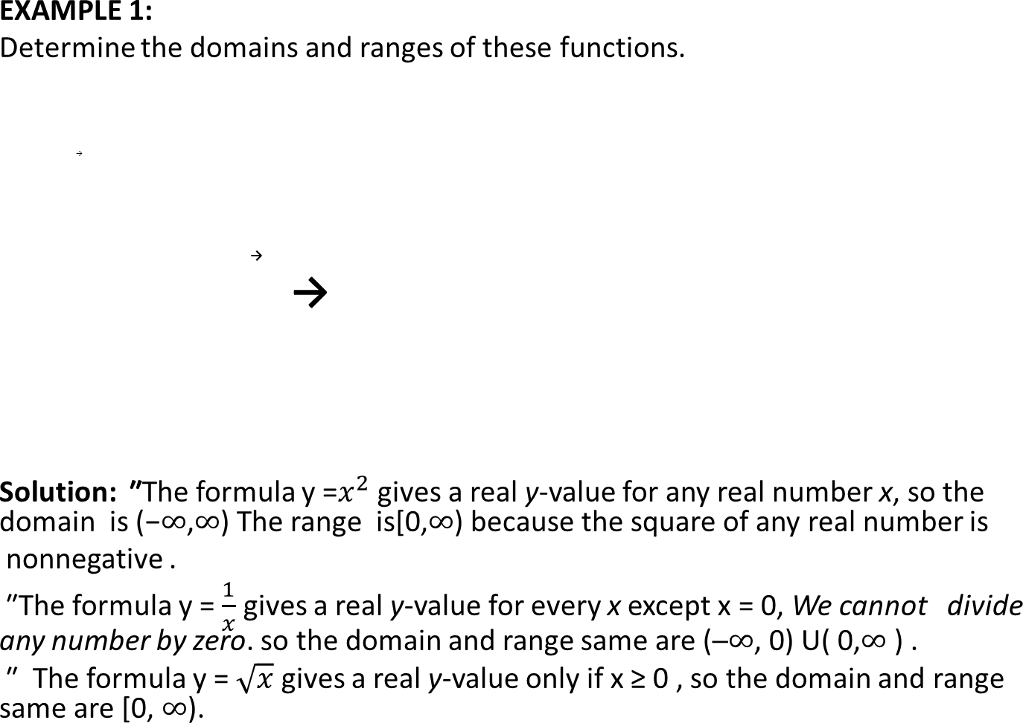
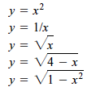
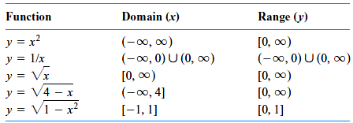

Slide 7
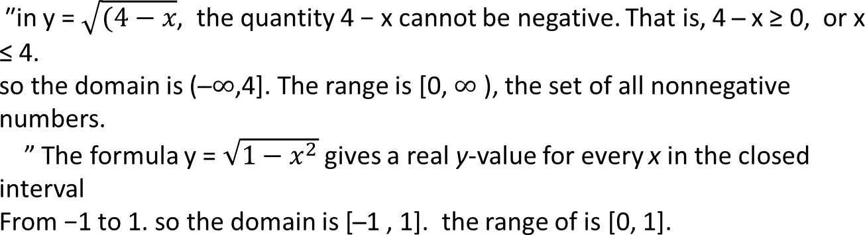
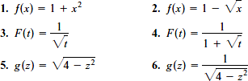
EXERCISES 1.3:
find the domain and range of each function.

Slide 8
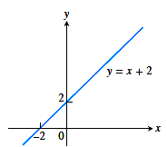
Graphs of Functions
If ƒ is a function with domain D, its graph consists of the points in the Cartesian plane whose coordinates are the input-output pairs for ƒ. In set notation, the graph is {( x ,ƒ(x)) | x ϵ D }. To graph the function we need,
  Make a table of xy-pairs that satisfy the function rule.
  Plot the points (x, y).
  Draw a smooth curve through the plotted points. Label the curve with its equation.
Example 2: Sketching a Graph
    Graph the function ƒ(x) = x + 2
Solution: The graph of the function ƒ(x) = x + 2
is the set of points with coordinates (x, y) for which
y = x + 2. Its graph is sketched in Figure.

Slide 9
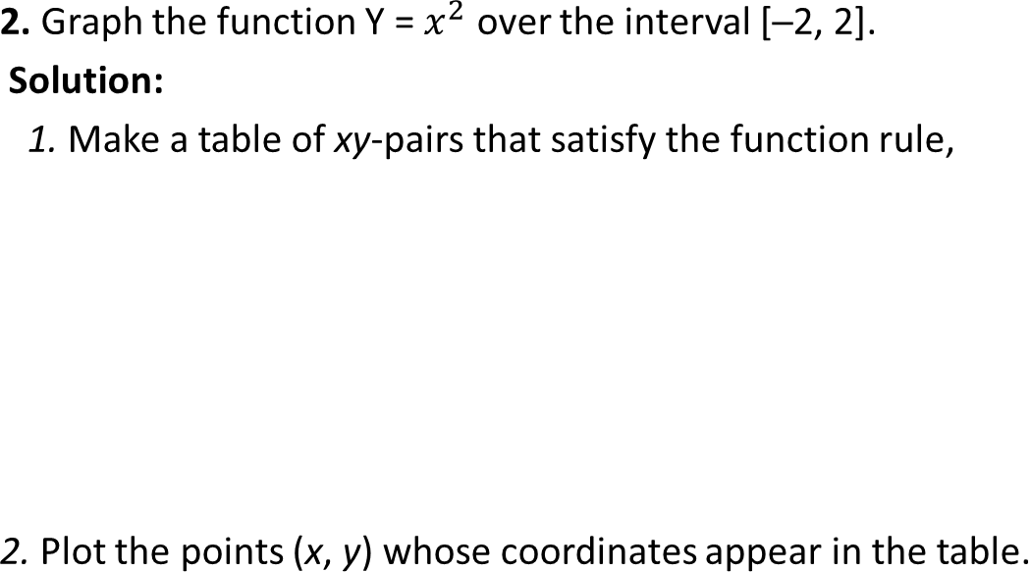
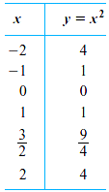
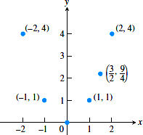

Slide 10
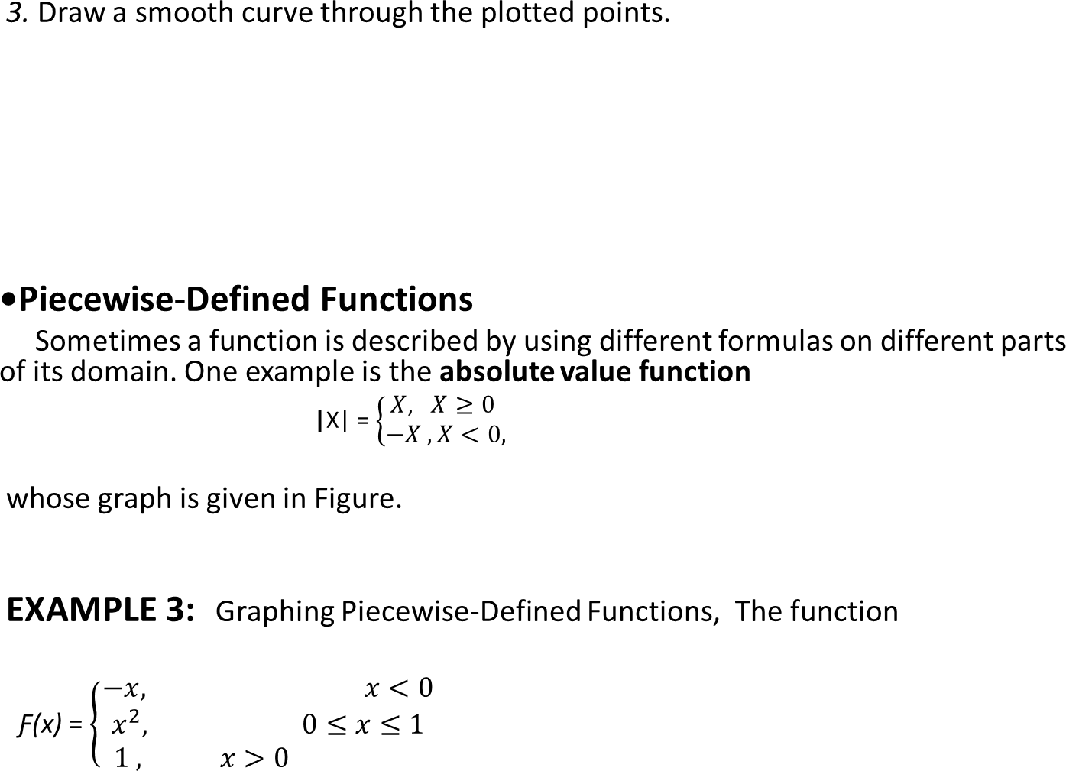
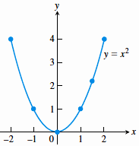
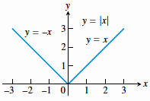

Slide 11
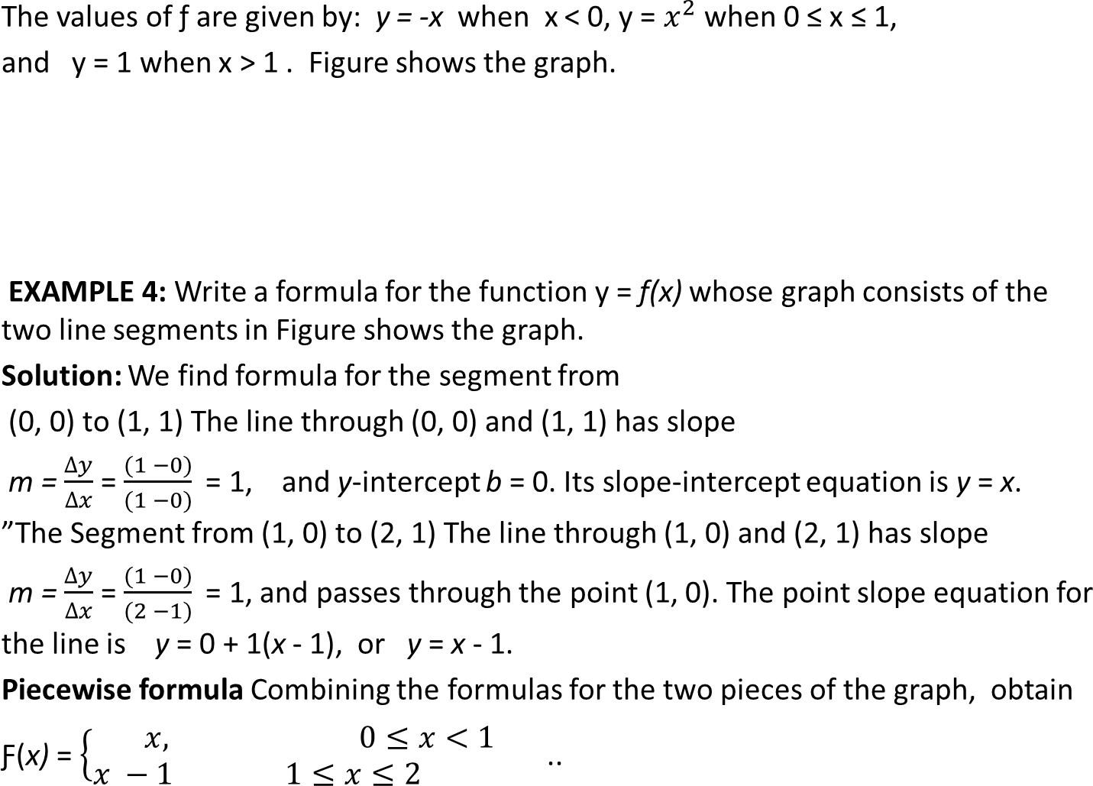
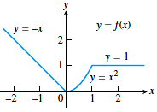
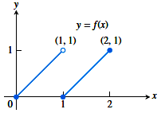

Slide 12
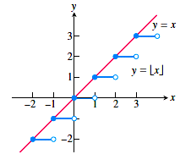
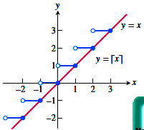
The Greatest and Least Integer Functions
The function whose value at any number x is the greatest integer less than or equal to x is called the greatest integer function, It is denoted, [x] or [[x]] or int x. Figure shows the graph.
[2.4] = 2 , [ 1.9 ] = 1 , [ 0 ] = 0 , [ 2 ] = 2, [ 0.2 ] = 0
The function whose value at any number x is the smallest integer greater than or equal to x is called the least integer function ,
[ -2 ] = - 2, [ - 1.2 ] = -2, [ - 0,3 ] = - 1 .

Slide 13
MATHEMATICS I
FIRST SEMESTER
04
Functions and Their Graphs
By Dr. Shaimaa Amen/Material engineering department/1st Grade/Calculus I

Slide 14
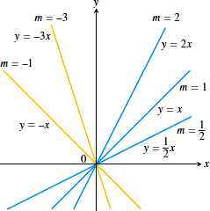
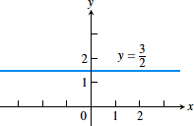
Types of functions
1. Linear Functions: A function of the form f(x) =mx +b for constants m and b, is
called a linear function. Figure shows an array of lines f(x) =mx where b = 0, so these lines pass through the origin.
”A Constant functions has slope m = 0, Figureshows.

Slide 15
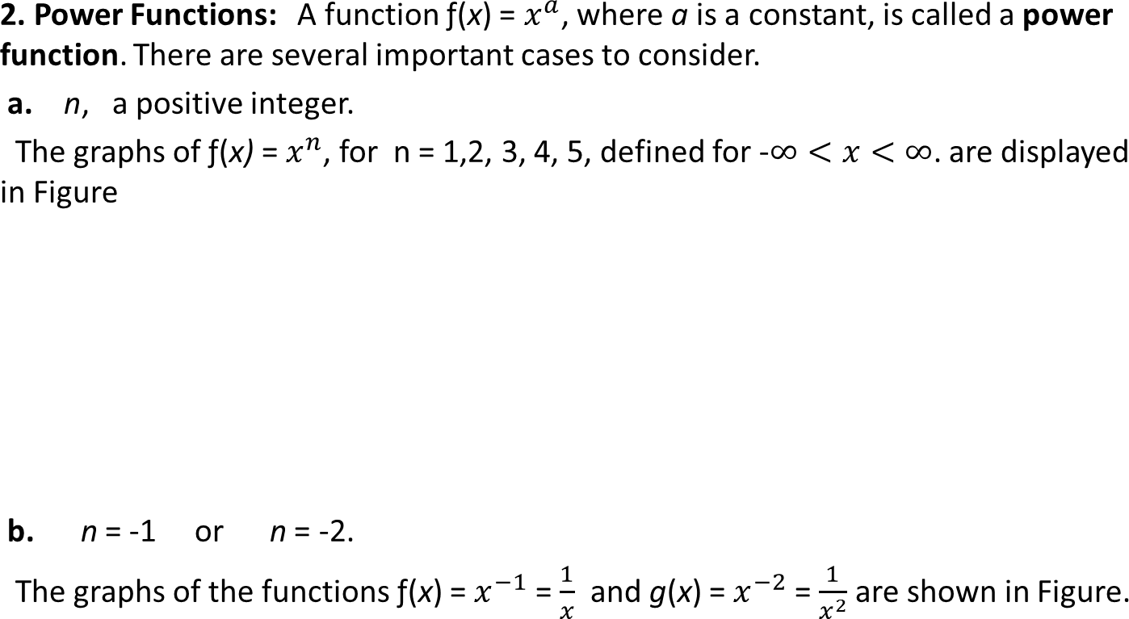
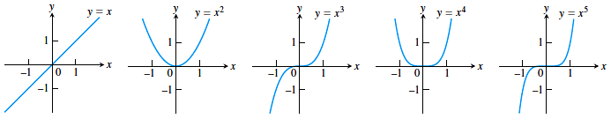

Slide 16
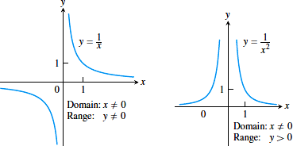

Slide 17
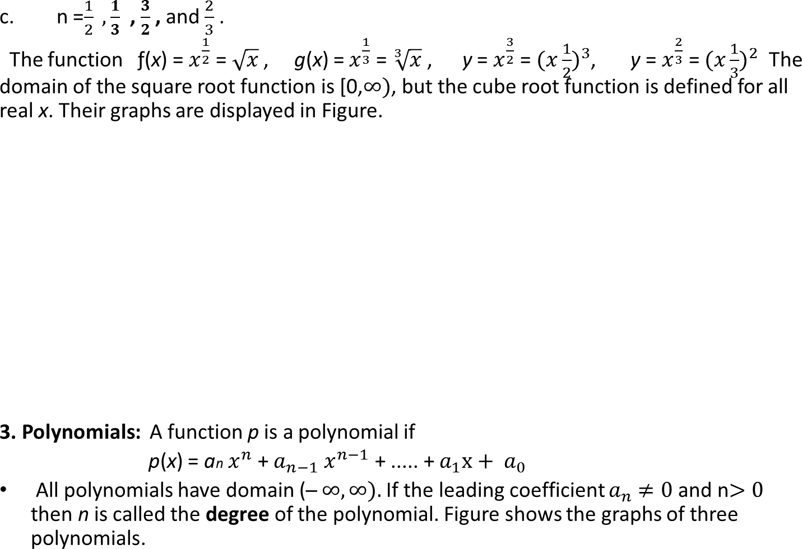
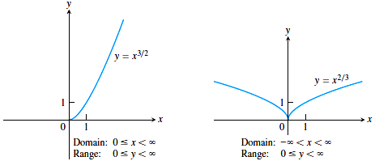
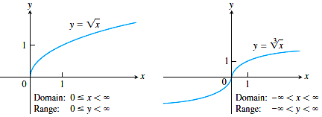

Slide 18
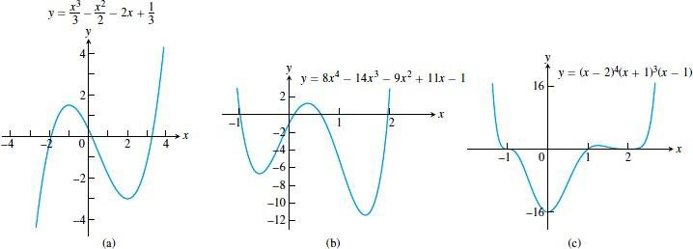
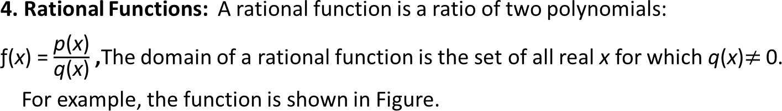
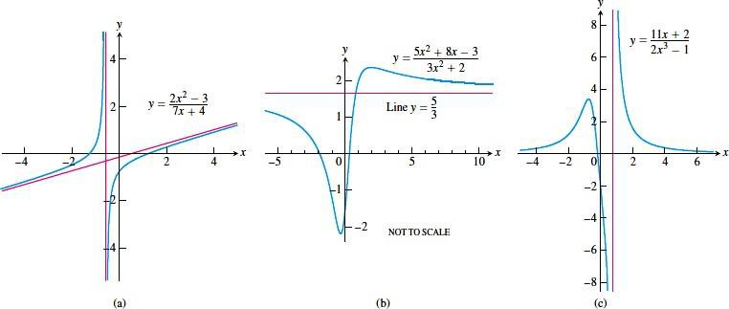

Slide 19
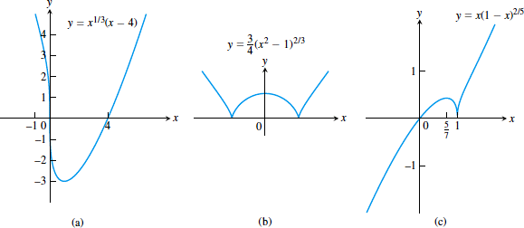
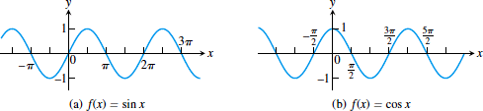
5. Algebraic Functions: An algebraic function is a function constructed from polynomials using algebraic operations (addition, subtraction, multiplication, division, and taking roots). Rational functions are special cases of algebraic functions. Figure displays the graphs of three algebraic functions.
6. Trigonometric Functions: The graphs trigonometric functions of the sine and
cosine functions are shown in Figure.

Slide 20

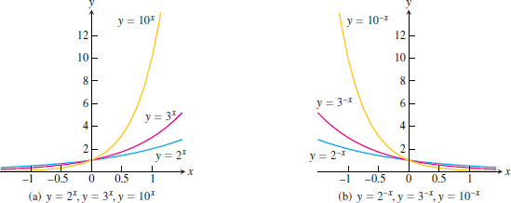

Slide 21
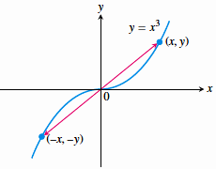
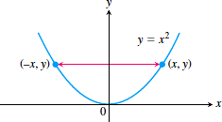
Even Functions and Odd Functions: Symmetry
A function y = ƒ(x) is an
even function of x if ƒ(-x) = ƒ(x),
odd function of x if ƒ(-x) = - ƒ(x),
for every x in the function’s domain.
”A function f is even if and only if the graph off is symmetric about they-axis.
”The graph of an odd function is symmetric about the origin.

Slide 22
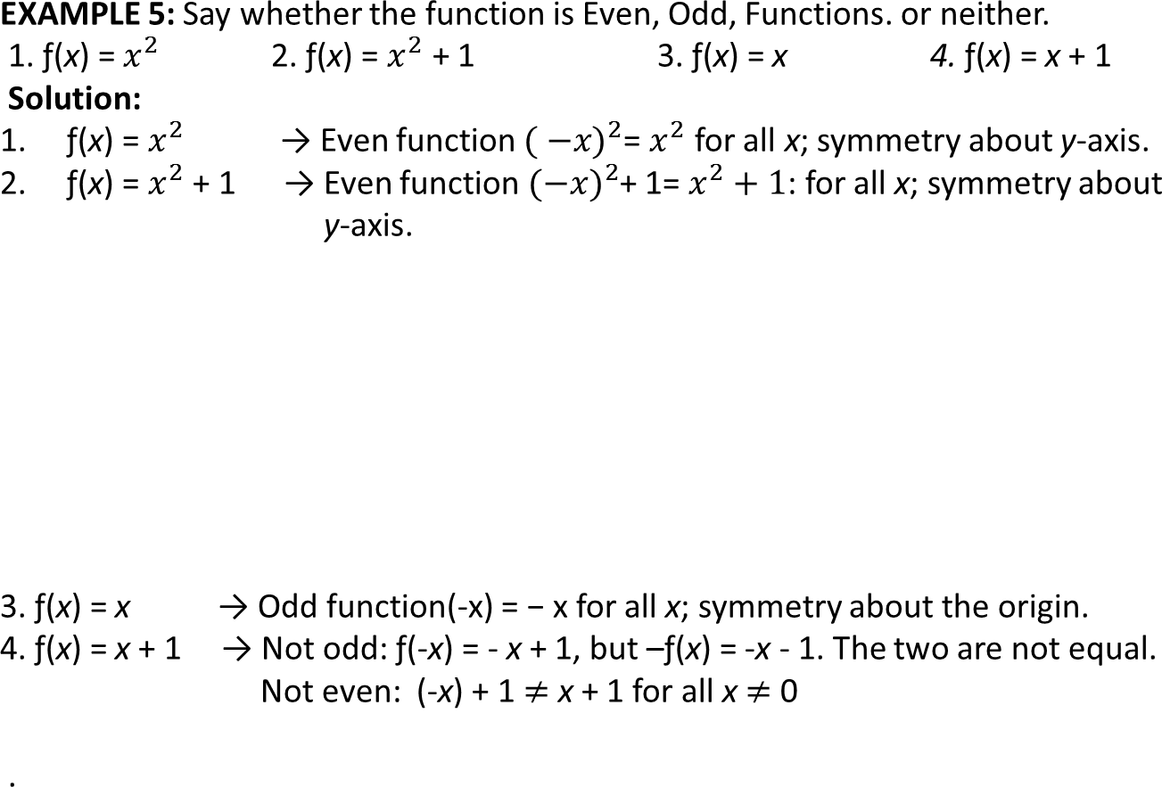
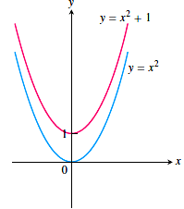
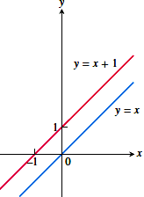

Slide 23
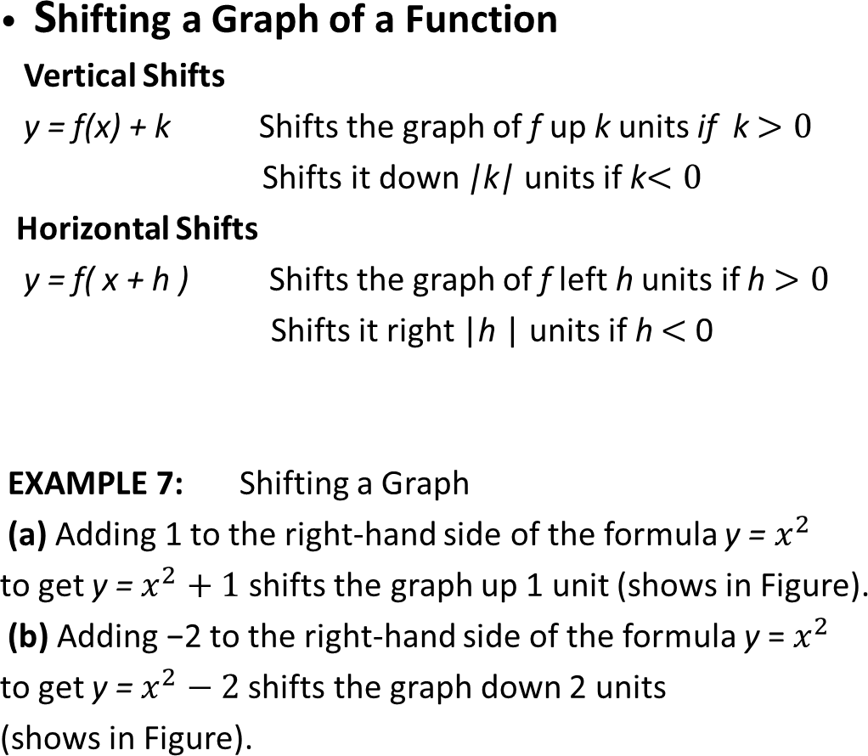
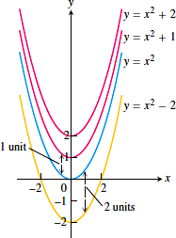

Slide 24
